Slide 1
MVIN: Learning Multiview Items for Recommendation
SIGIR 2020
汇报人：高钰澜
时间：2021年4月18日

Slide 2

1.Background
DIRECTORY
目录
2.Model
3.Experiment

Slide 3
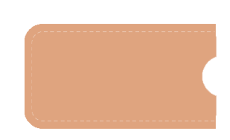
NO.1
Background

Slide 4
Background
knowledge graphs(KGs) : mitigate the cold start and sparsity issues.
However, utilizing a graph neural network (GNN) to capture information in KG and further apply in RS is unable to see each item’s properties from multiple perspectives.
multi-view item network (MVIN), a GNN-based recommendation model which provides superior recommendations by describing items from a unique mixed view from user and entity angles.

Slide 5
NO.2
Model

Slide 6
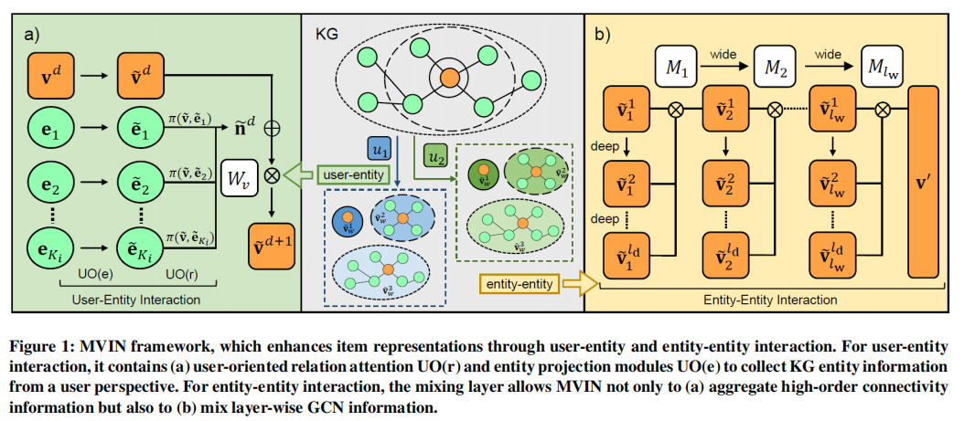
Model

Slide 7




User-Entity Interaction
(1) User-Oriented Relation Attention
(2) User-Oriented Entity Projection

Slide 8
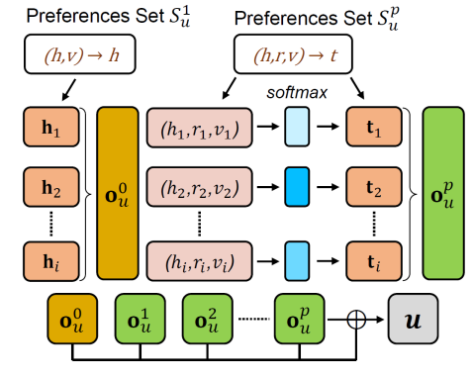



User-Entity Interaction
(3) KG-Enhanced User Representation.
preference set：

Slide 9



Entity-Entity Interaction

Slide 10
NO.3
Experiments

Slide 11
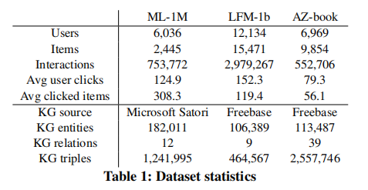
Experiments
Datasets：MovieLens-1M, LFM-1b 2015 and Amazon-book

Slide 12
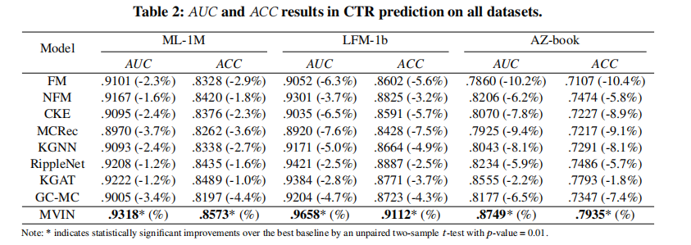
Experimental Results

Slide 13
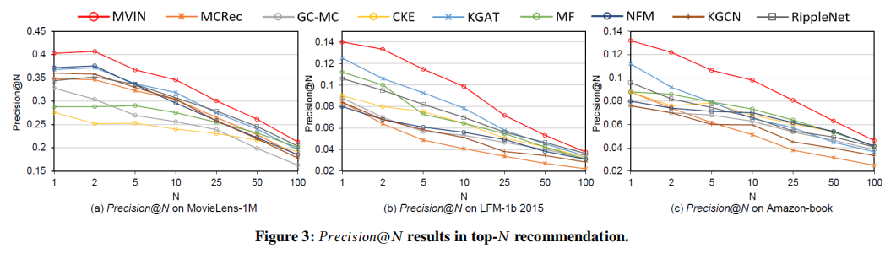

Slide 14
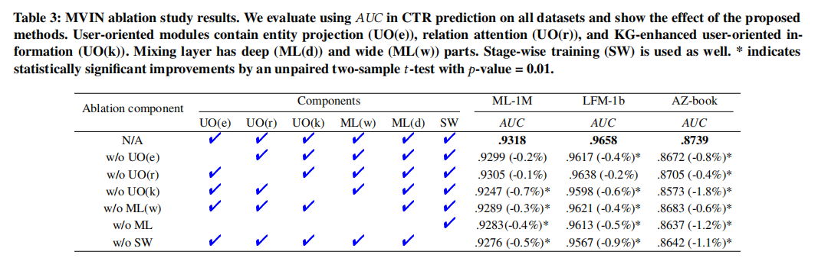
Ablation study

Slide 15
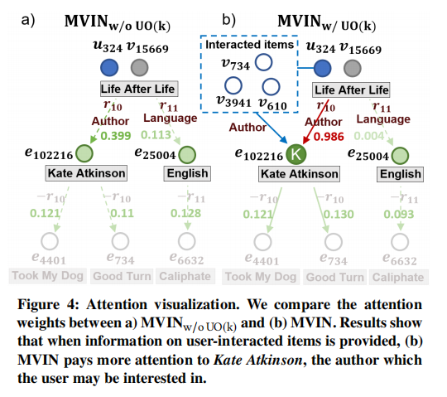
a case study to understand the effect of KG-enhanced user-oriented information incorporated with user-entity interaction.

Slide 16
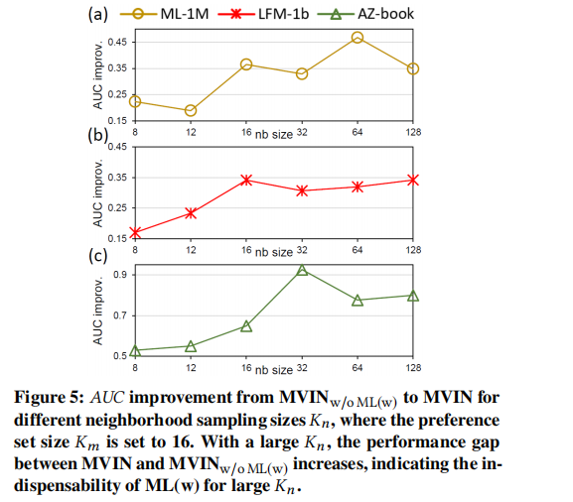
Figure 5 shows that ML(w) （wide part） is effective in heterogeneous graphs.

Slide 17
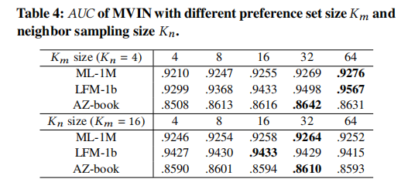
Preference set sample size K_{m}
Neighborhood entity sample size K_{n}

Slide 18
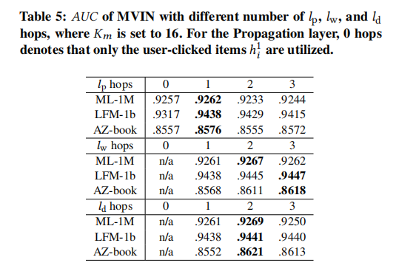
Number of preference hops l_{p}
Number of wide hops l_{w} and deep hops l_{d}

Slide 19
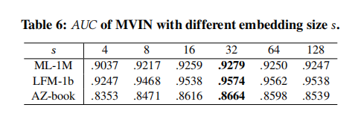
Dimension of embedding size s

Slide 20
Thanks for watching
汇报人：高钰澜
时间：2021年4月18日

